Slide 1
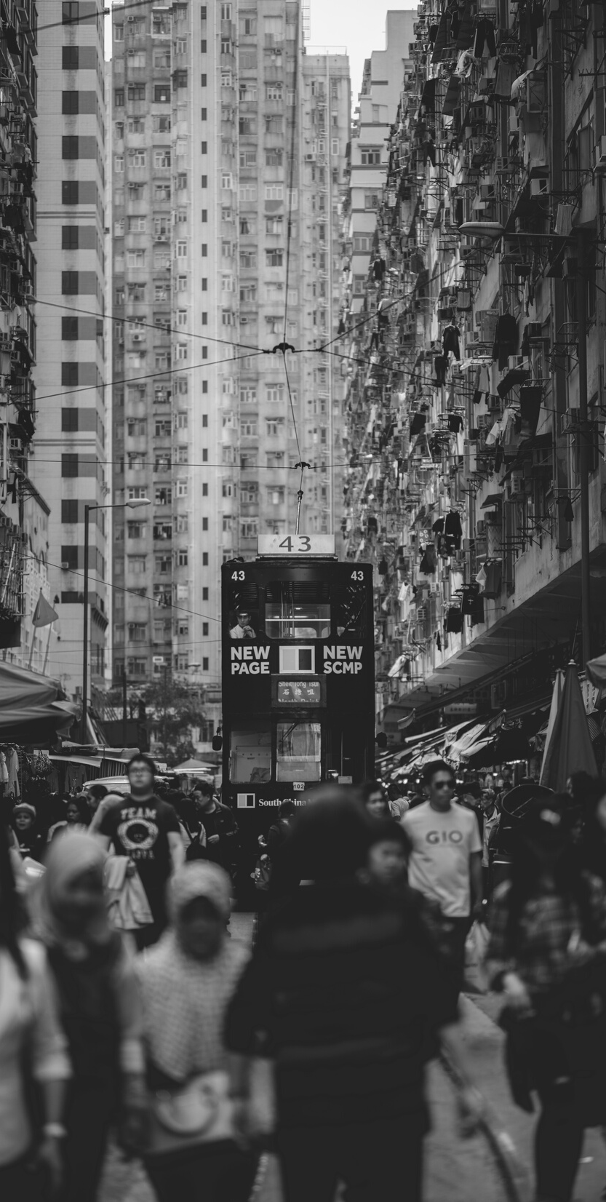
Smart Traffic Light Control
MMAI 845 REINFORCEMENT LEARNING
Team Lansdowne
Ariel Wang, Benjamin Castro, Brigitte Reda, Carol Guo, Josh Daiter,
Mitch Johnstone, Mohammad Ismail, Tarig Ibrahim

Slide 2
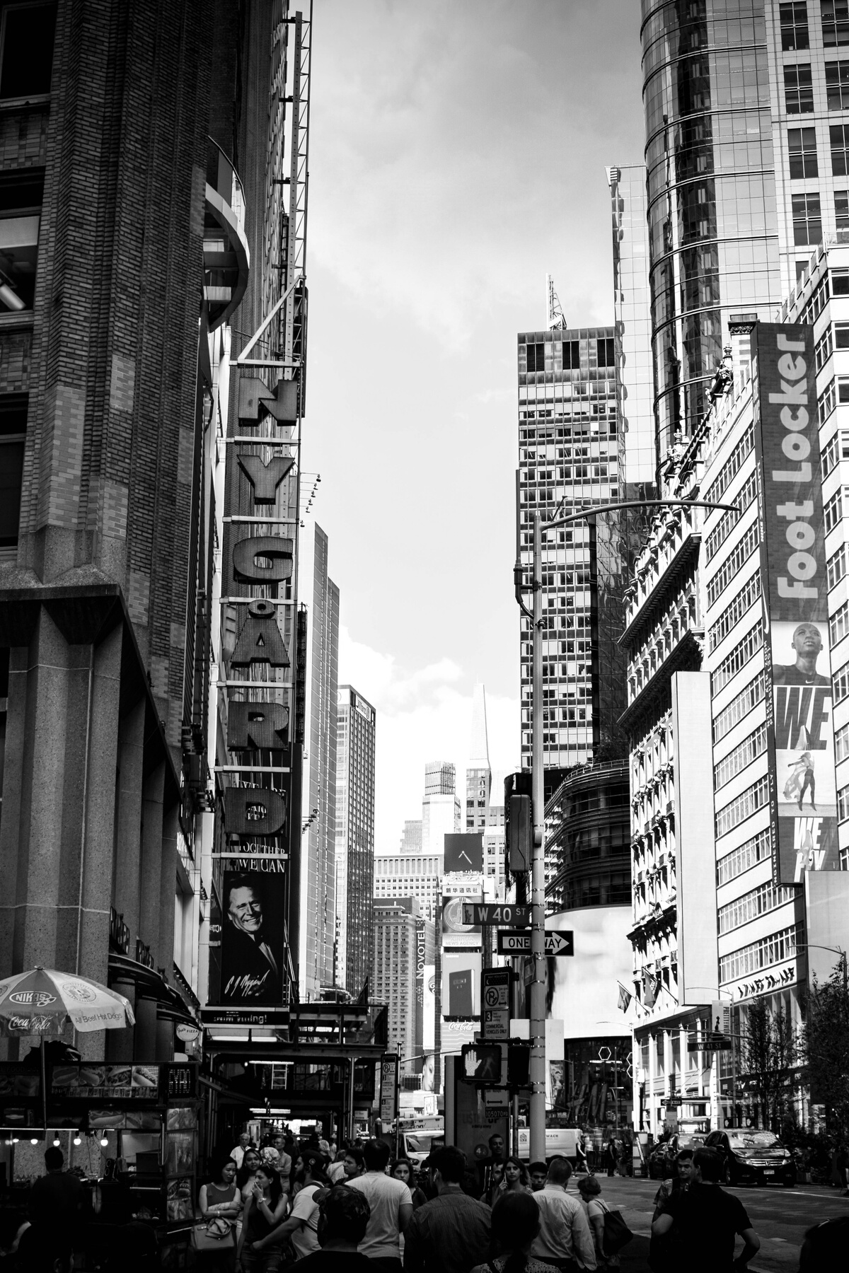
Presentation Outline
Topics to Discuss
TEAM LANSDOWNE
Background
Fixed Traffic Light Control System
Reinforcement Learning model
Model Environment
Conclusion
Opportunities
Q&A
02

Slide 3
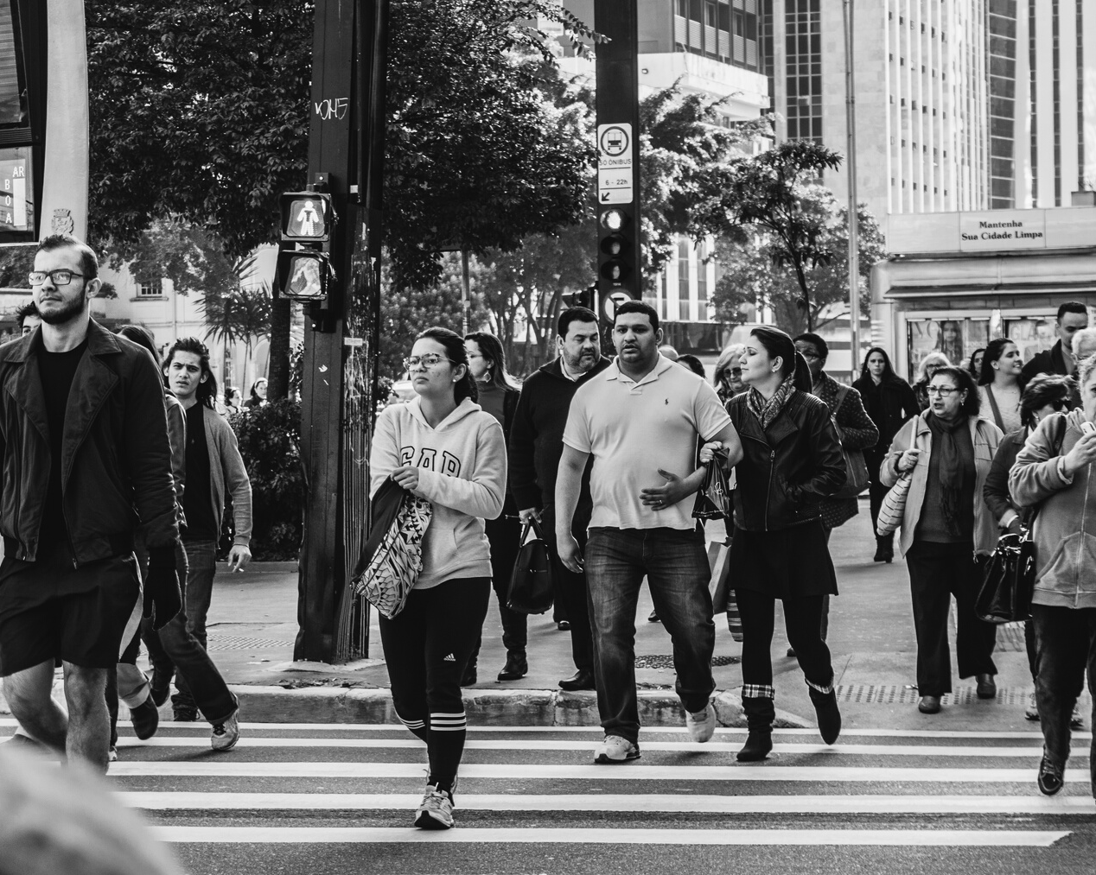
A Brief Background
The designed function of traffic light is to allow moto vehicles and pedestrians move smoothly and safely. The first automated traffic control system is made in 1954 and used in Toronto.
Traffic congestion is rising in cities around the world. The impacts are significant. INRIX, location-based data and analytics company assesses that traffic jam cost commuters about $305 billion in 2017 due to wasted fuel, lost time and the increased cost of transporting goods through congested areas. This leads to the importance of improve traffic conditions.
TEAM LANSDOWNE
03

Slide 4
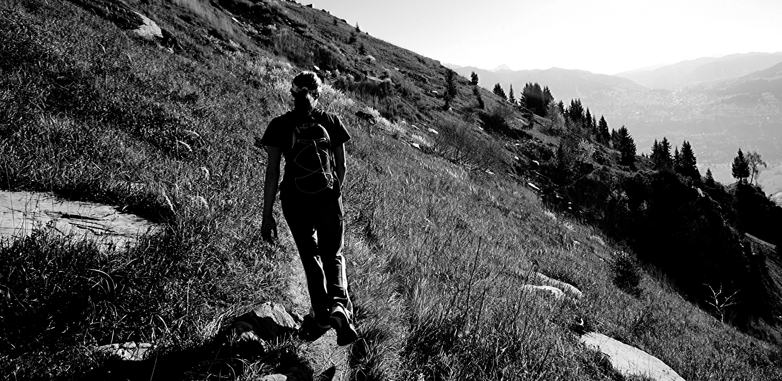
Our Approach
Fixed Traffic Light Control System
Reinforcement Learning model
Implement a Deep Q-Learning Agent for Traffic Signal Control as an initial model
Identify performance and limitations (stress-test) of the Deep Q-Learning Agent
Fix seconds of wait time at the light
System does not adjust light duration to the traffic conditions
04
Notes:
Fixed time control:
- uses Electro-mechanical Signal Controller which is based on a Dial Timer that has fixed and signalized intersection time plans.
- Cycle lengths (of signalized intersections) are determined by small cycle gears that are located within dial timers,
- Cycle gears range from 35 - 120 seconds
- a dial Timer only has 1 signal intersection time plan so that it only controls 1 way at a intersection.

Slide 5
Model Environment and States
TEAM LANSDOWNE
05
https://github.com/AndreaVidali/Deep-QLearning-Agent-for-Traffic-Signal-Control

Slide 6
Study Scenarios
SCENARIO 1
Original DQL
Deep Q Learning model performance vs a traditional Fixed Time Light System
4 lanes per arm
Weibull parameter: 2 (traffic)
Cars per episode: 1000
TEAM LANSDOWNE
SCENARIO 2
Traffic Distribution
Model performance with variations in the traffic distribution
4 lanes per arm
Weibull parameter: 3.5 (traffic)
Cars per episode: 1000
SCENARIO 3
Reduced Lanes # &
Increase cars #
Model behavior with variations in number of lanes and number of cars
3 lanes per arm
Weibull parameter: 2 (traffic)
Cars per episode: 500
06

Slide 7
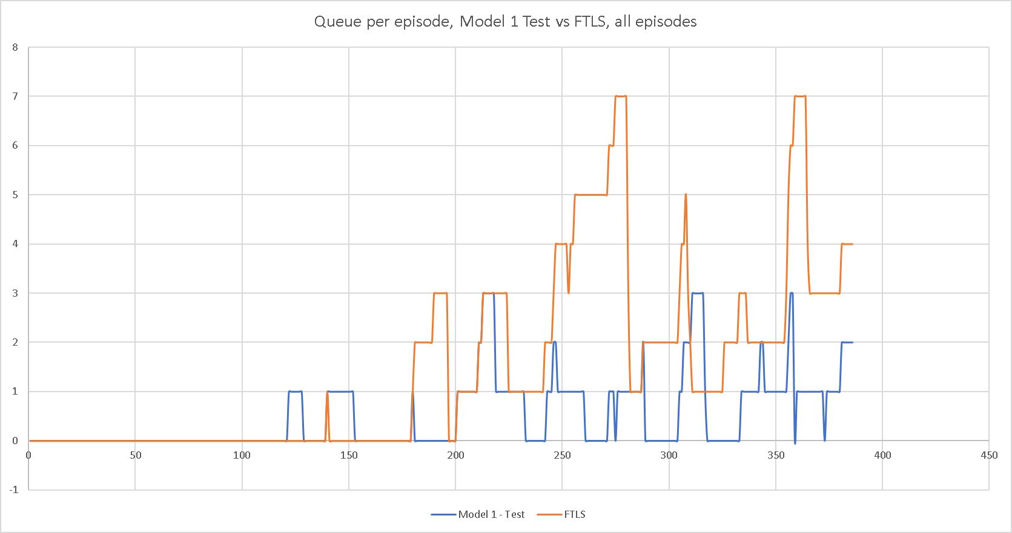
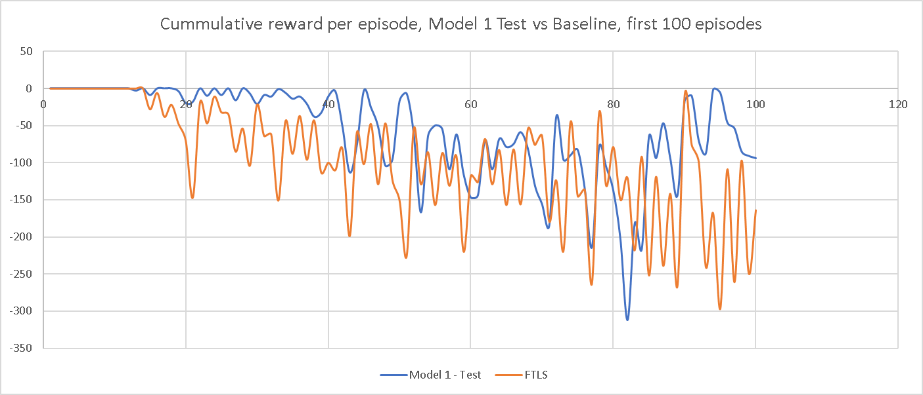
Key Takeaway:
The RL model has better performance than the fixed time light system, both in waiting time and in queue length
Scenario 1
Original DQL vs FLTS
09

Slide 8
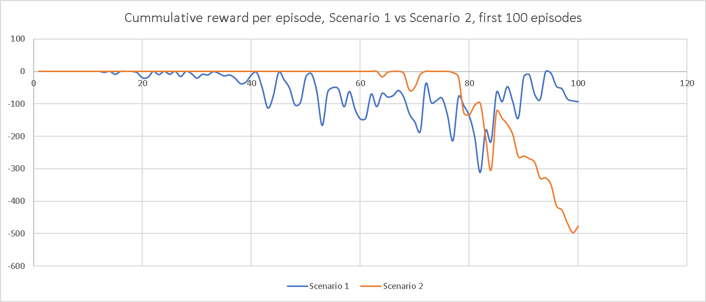
Scenario 2 vs Scenario 1
Traffic Distribution vs Original DQL
Key Takeaway:
Even though the model was re-trained with the new traffic distribution, the change negatively impacts the performance
10

Slide 9
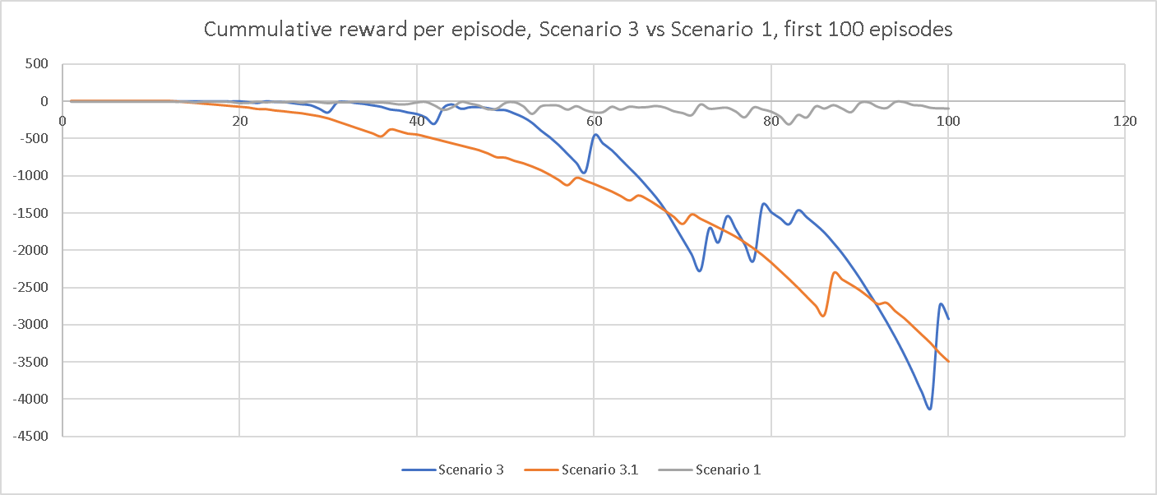
Scenario 3 vs Scenario 1 Three lanes vs Four lanes
Key Takeaway:
The change in number of lanes significantly affects the model performance
11

Slide 10
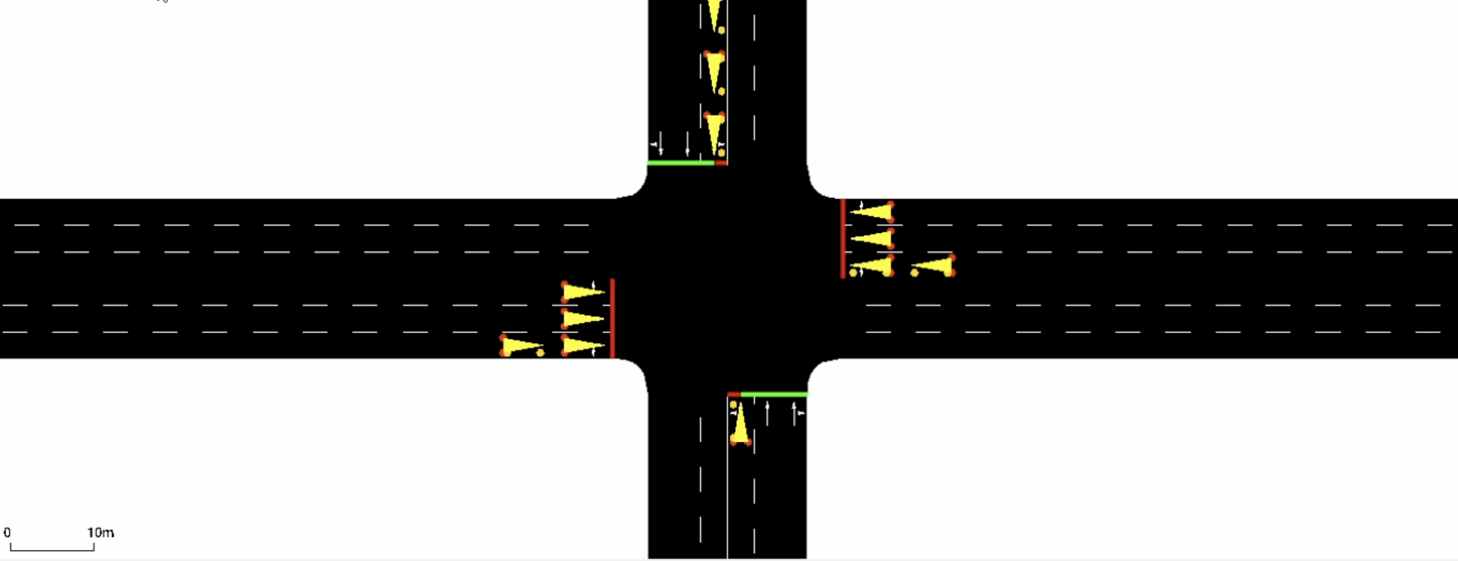
Deep Q Learning - Tuned 3 Lanes
clip
Episodes=100, Cars=500, Epochs=50, Lanes=3
12

Slide 11
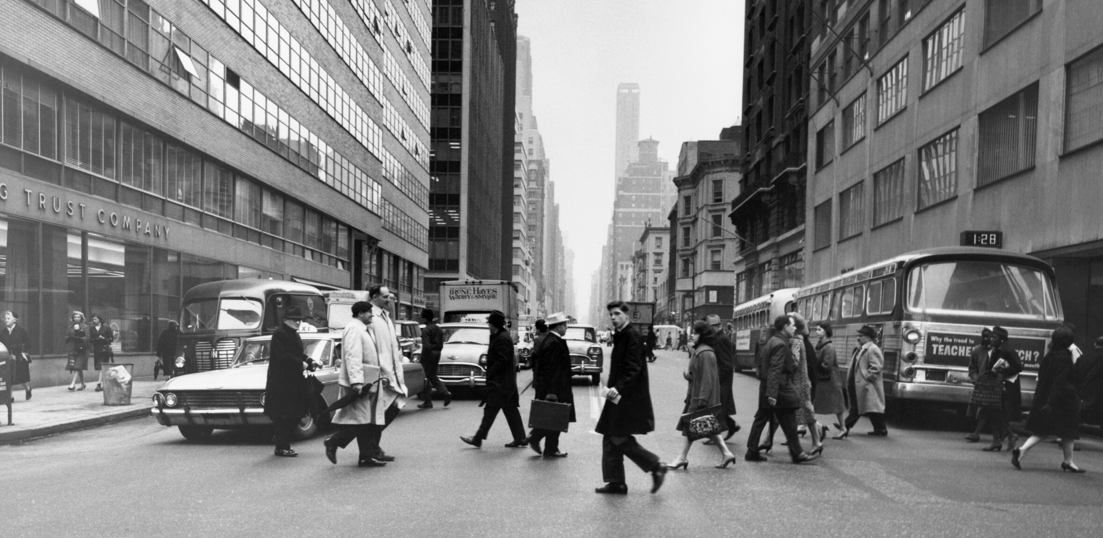
D
Conclusion
Smart Traffic Light Control
As expected, the RL model shows a more efficient performance than a traditional fixed traffic light system.
DQN was ~2 times better
Exploring the model with different environments (number of cars, lanes, traffic distribution) show major changes in queue length and reward whether positively or negatively which requires more training
13
Notes:
when the traffic light has fixed number of seconds for green and yellow lights, the lanes quickly became congested jammed.
Imagine waiting in traffic half the time!

Slide 12
Opportunities
More episodes and more epochs
Test other environmental variables
Type of cars
Privilege lanes
Pedestrian use
3. Share learning to optimize other domains (ex.air traffic control & Shipping Ports)
02
TEAM LANSDOWNE
14
Notes:
o Airports to erect camera masts and microphones that transmit data to a separate control centre.
o Air traffic control (ATC) automation system
o The system to complete fallback flight data processing, flight plan synchronisation, multi-sensor processing and sending alerts to ensure consistent operations.
o to decrease flight delays and increase air capacity. It provides a seamless integration between area control, approach control and tower systems.
-

Slide 13
TEAM LANSDOWNE
Q&A
Thank You
15

Slide 14
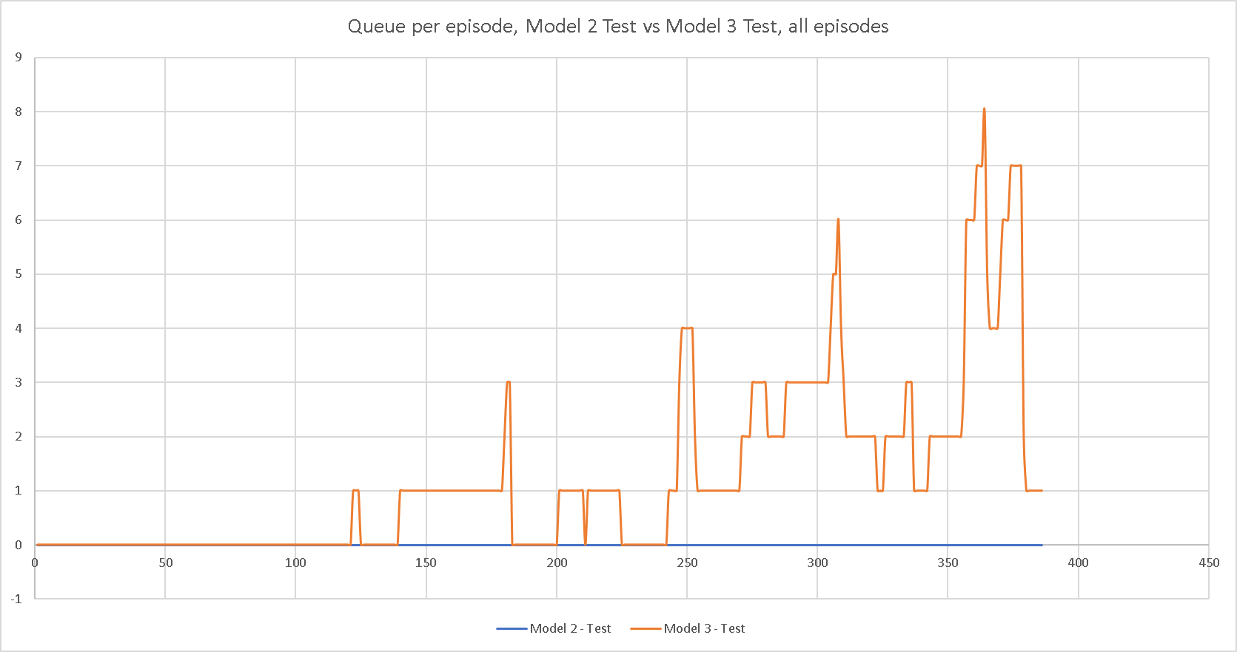
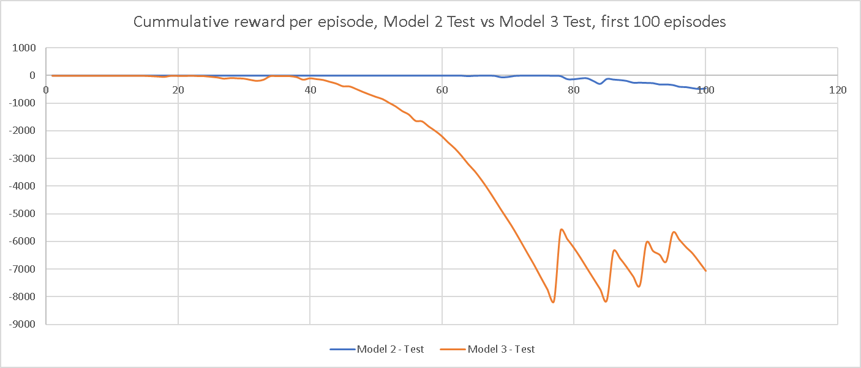
Appendix: Scenario 2: Traffic Distribution

Slide 15
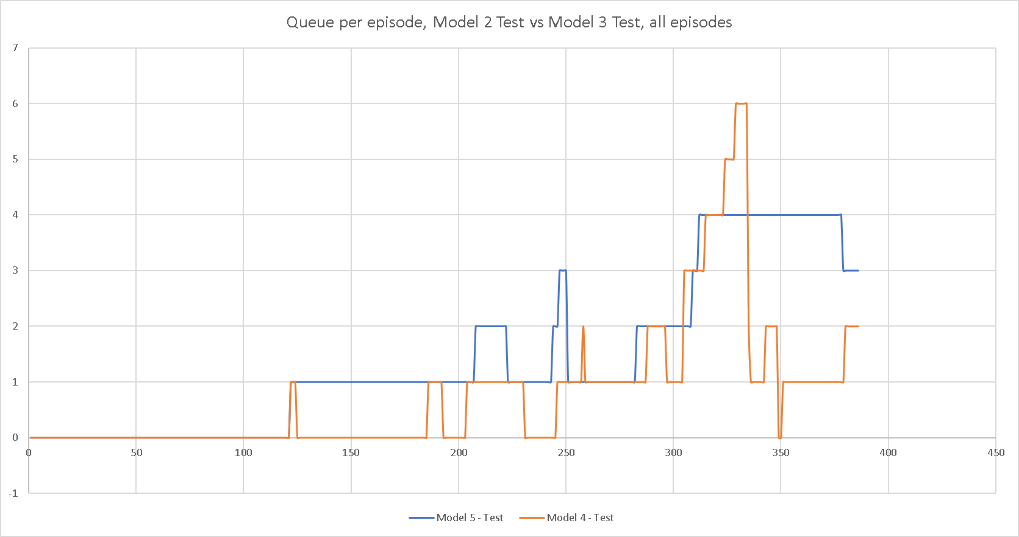
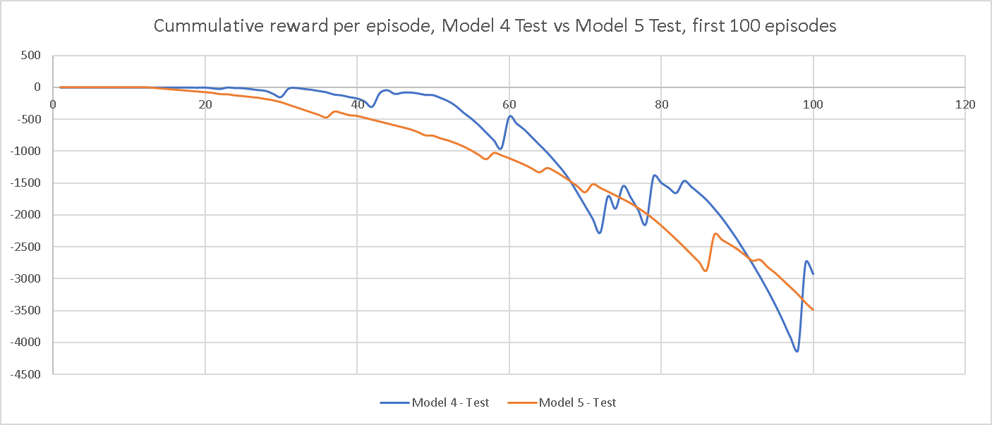
Appendix: Scenario 3: Fewer lanes, more cars

Slide 16
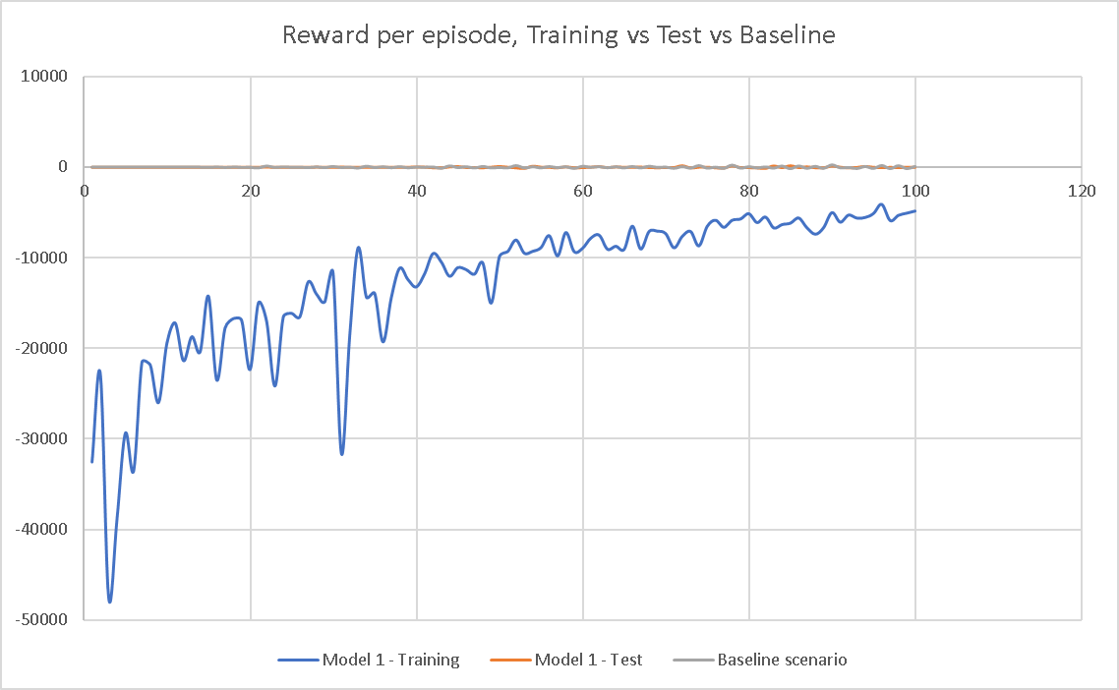
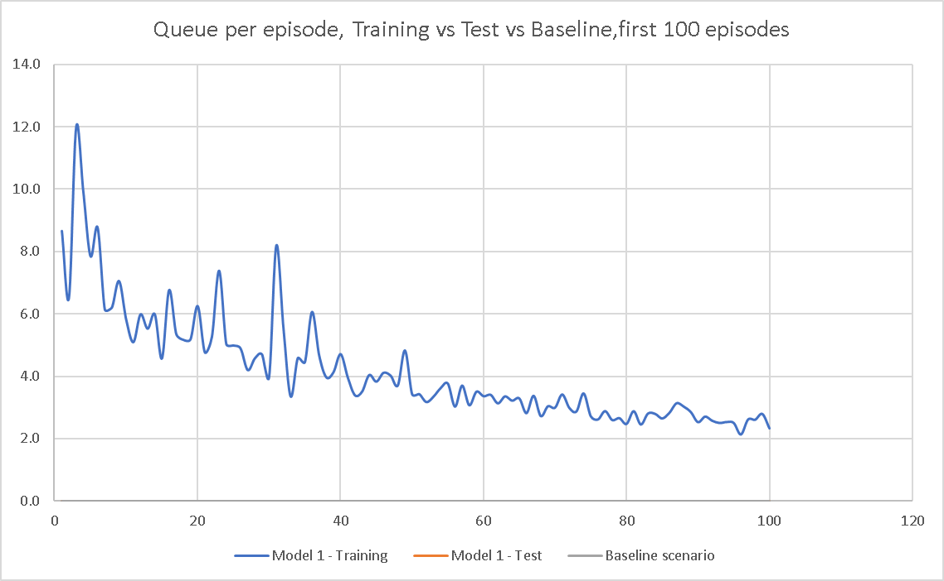
Training Results – Rewards and Car Queues per Episode
07
Notes:
Weibull with k=2,
Weibull

Slide 17
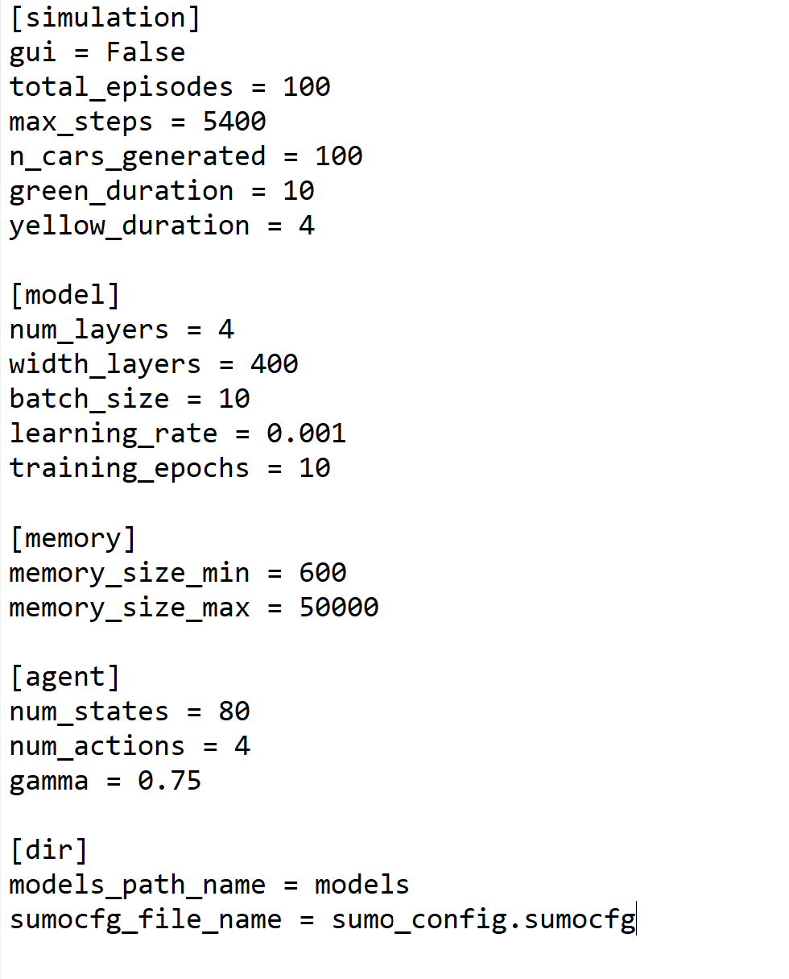

Slide 18
